Slide 1
Info
Bulletproof Your SQL Server Development Environment
Based on the provided sources and our conversation history, here is a detailed presentation slide outline and supporting lab ideas for the "Build a Bulletproof SQL Server Development Environment" 60-minute session:
The session's core purpose is to help attendees "level up their Scripting and Development capabilities" [1-3] by addressing the common challenge of being "tired of looking for or hunting for scripts" [1-3]. It aims to teach how to achieve a "bulletproof" SQL Server development environment [1, 3].
--------------------------------------------------------------------------------
Presentation Slide Outline & Supporting Labs
Session Title Slide:
Build a Bulletproof SQL Server Development Environment
Your Name / Presenter
Session Goal: To "level up your Scripting and Development capabilities" [1-3].
--------------------------------------------------------------------------------
I. The Foundation: Why a Bulletproof Environment and Setting Up Your IDE (Approx. 20-25 minutes)

Slide 2
Slide 1: Introduction - Are You Tired?
◦ Hook/Problem Statement: "Are you tired of looking for or hunting for scripts?" [1-3]
◦ The Cost of Inefficiency: Briefly touch upon time wasted, errors, and frustration.
◦ Solution Preview: Introduce the concept of a "bulletproof" SQL Server development environment [1, 3].

Slide 3
Slide 2: Session Goals - Level Up!
◦ Main Objective: "Level up your Scripting and Development capabilities" [1-3].
◦ Key Outcomes: You will leave with "skills and strategies" [2, 4] to significantly "improve efficiency, documentation, and collaboration" [2, 4].

Slide 4
Slide 3: What is an Integrated Development Environment (IDE) for DBAs?
◦ Definition: Briefly explain what an IDE is in the context of SQL Server development.
◦ Components: Mention common tools or functionalities that make up such an environment.

Slide 5
Slide 4: Setting Up Your IDE - The Core Focus
◦ Purpose: This section involves "walking through setting up an integrated development environment for the SQL Server DBA" [2, 3, 5].
◦ Practical Steps: Highlight the "practical steps and components involved" [3, 5] in establishing this foundational environment.
◦ Lab Introduction: Introduce the upcoming hands-on component.
--------------------------------------------------------------------------------

Slide 6
Supporting Lab 1: Setting Up Your Core SQL Server Development Environment
Goal: To walk attendees through the fundamental setup of their development environment. This is crucial for creating the foundational "bulletproof" setup [3].
Potential Activities (Demo or Guided Lab): * SQL Server Management Studio (SSMS) Configuration: [This information is not directly in the sources, but SSMS is the primary IDE for SQL Server DBAs, so its configuration would be a logical "practical step" within "walking through setting up an integrated development environment for the SQL Server DBA" [1, 3, 5].] * Basic layout, keyboard shortcuts. * Connecting to SQL Server instances. * Introduction to Source Control Integration (e.g., Git/Azure DevOps Repos): [While the sources mention "collaboration" [1, 2, 4-7], specific tools like Git or Azure DevOps are not named. However, source control is a common component of an "integrated development environment" for collaboration, making it a logical inclusion for a lab covering "practical steps and components" [3, 5].] * Brief overview of its purpose for scripts and database objects. * How to initialize a simple repository or connect to one. * Folder Structure Best Practices: [This detail is not explicitly stated in the sources but falls under "practical steps and components involved" in setting up an efficient environment [3, 5].] * Organizing scripts, queries, and project files.
--------------------------------------------------------------------------------
II. Elevating Your Workflow: Skills and Strategies for Improvement (Approx. 25-30 minutes)

Slide 7
Slide 5: Improving Efficiency - Work Smarter, Not Harder
◦ Overview: Learn "skills and strategies to make your development process more efficient" [1, 2, 4-7].
◦ Specific Strategies: * SQL Snippets/Templates: How to create and use reusable code blocks. * Custom Keyboard Shortcuts: Accelerating common tasks. * Query Shortcuts in SSMS: [This is an SSMS-specific feature not explicitly mentioned, but aligns with "skills and strategies to make your development process more efficient" [1, 7].] * Script Generation Tools: Using built-in or external tools for common DDL/DML.

Slide 8
Slide 6: Improving Documentation - The Future You Will Thank You
◦ Importance: Acquire "techniques and strategies for better documenting your scripts and environment" [1, 5-7]. Emphasize that "proper documentation is vital for maintainability and collaboration" [7].
◦ Methods: * In-Script Comments: Best practices for internal documentation. * Markdown/README Files: Creating external documentation for projects and repositories. * Extended Properties for Database Objects: Documenting tables, columns, etc. [This is a SQL Server specific feature not explicitly mentioned but supports "better documenting your scripts and environment" [1, 7].]

Slide 9
Slide 7: Improving Collaboration - Together We're Stronger
◦ Goal: Discover "strategies to enhance collaboration within your team using the integrated environment" [1, 2, 4-7].
◦ Key Strategies: * Version Control Workflows: Branching, merging, pull requests for scripts. * Shared Repositories: Centralized location for team scripts and projects. * Code Reviews: Peer feedback for quality and consistency. * Standardization: Establishing team-wide coding standards for consistency.
--------------------------------------------------------------------------------

Slide 10
Supporting Lab 2: Applying Efficiency, Documentation, and Collaboration Techniques
Goal: To give attendees hands-on experience with the practical skills and strategies discussed.
Potential Activities (Demo or Guided Lab): * Efficiency Practice: * Create a custom SSMS snippet or template for a common query. * Configure a useful keyboard shortcut. * Documentation Practice: * Add effective comments to an existing script. * Create a simple README.md file for a script project using Markdown. * Collaboration Simulation (if possible): * Demonstrate a basic Git workflow (commit, push, pull) with a sample script [While specific Git actions are not mentioned, "strategies to enhance collaboration" and "using the integrated environment" [1, 7] imply such functionality]. * Show how team members can share and contribute to scripts via a shared repository.
--------------------------------------------------------------------------------
III. Empowering Your Development Capabilities: Key Takeaways (Approx. 5-10 minutes)

Slide 11
Slide 8: Key Takeaways - Your Bulletproof Toolkit
◦ Reinforcement: Reiterate that attendees will leave with "skills and strategies designed to significantly improve their efficiency, documentation, and collaboration within a SQL Server development context" [1, 2, 4, 6].
◦ Summary of Benefits: * Increased Efficiency: Faster development, less "hunting for scripts" [1-3]. * Better Documentation: Easier maintenance, understanding, and onboarding. * Enhanced Collaboration: Smoother teamwork, consistent code.

Slide 12
Slide 9: Your Next Steps - Continue the Journey
◦ Call to Action: Encourage attendees to immediately apply what they've learned.
◦ Resources: (e.g., links to tools, documentation, community forums) [This is an common presentation practice but is not directly from the sources].

Slide 13

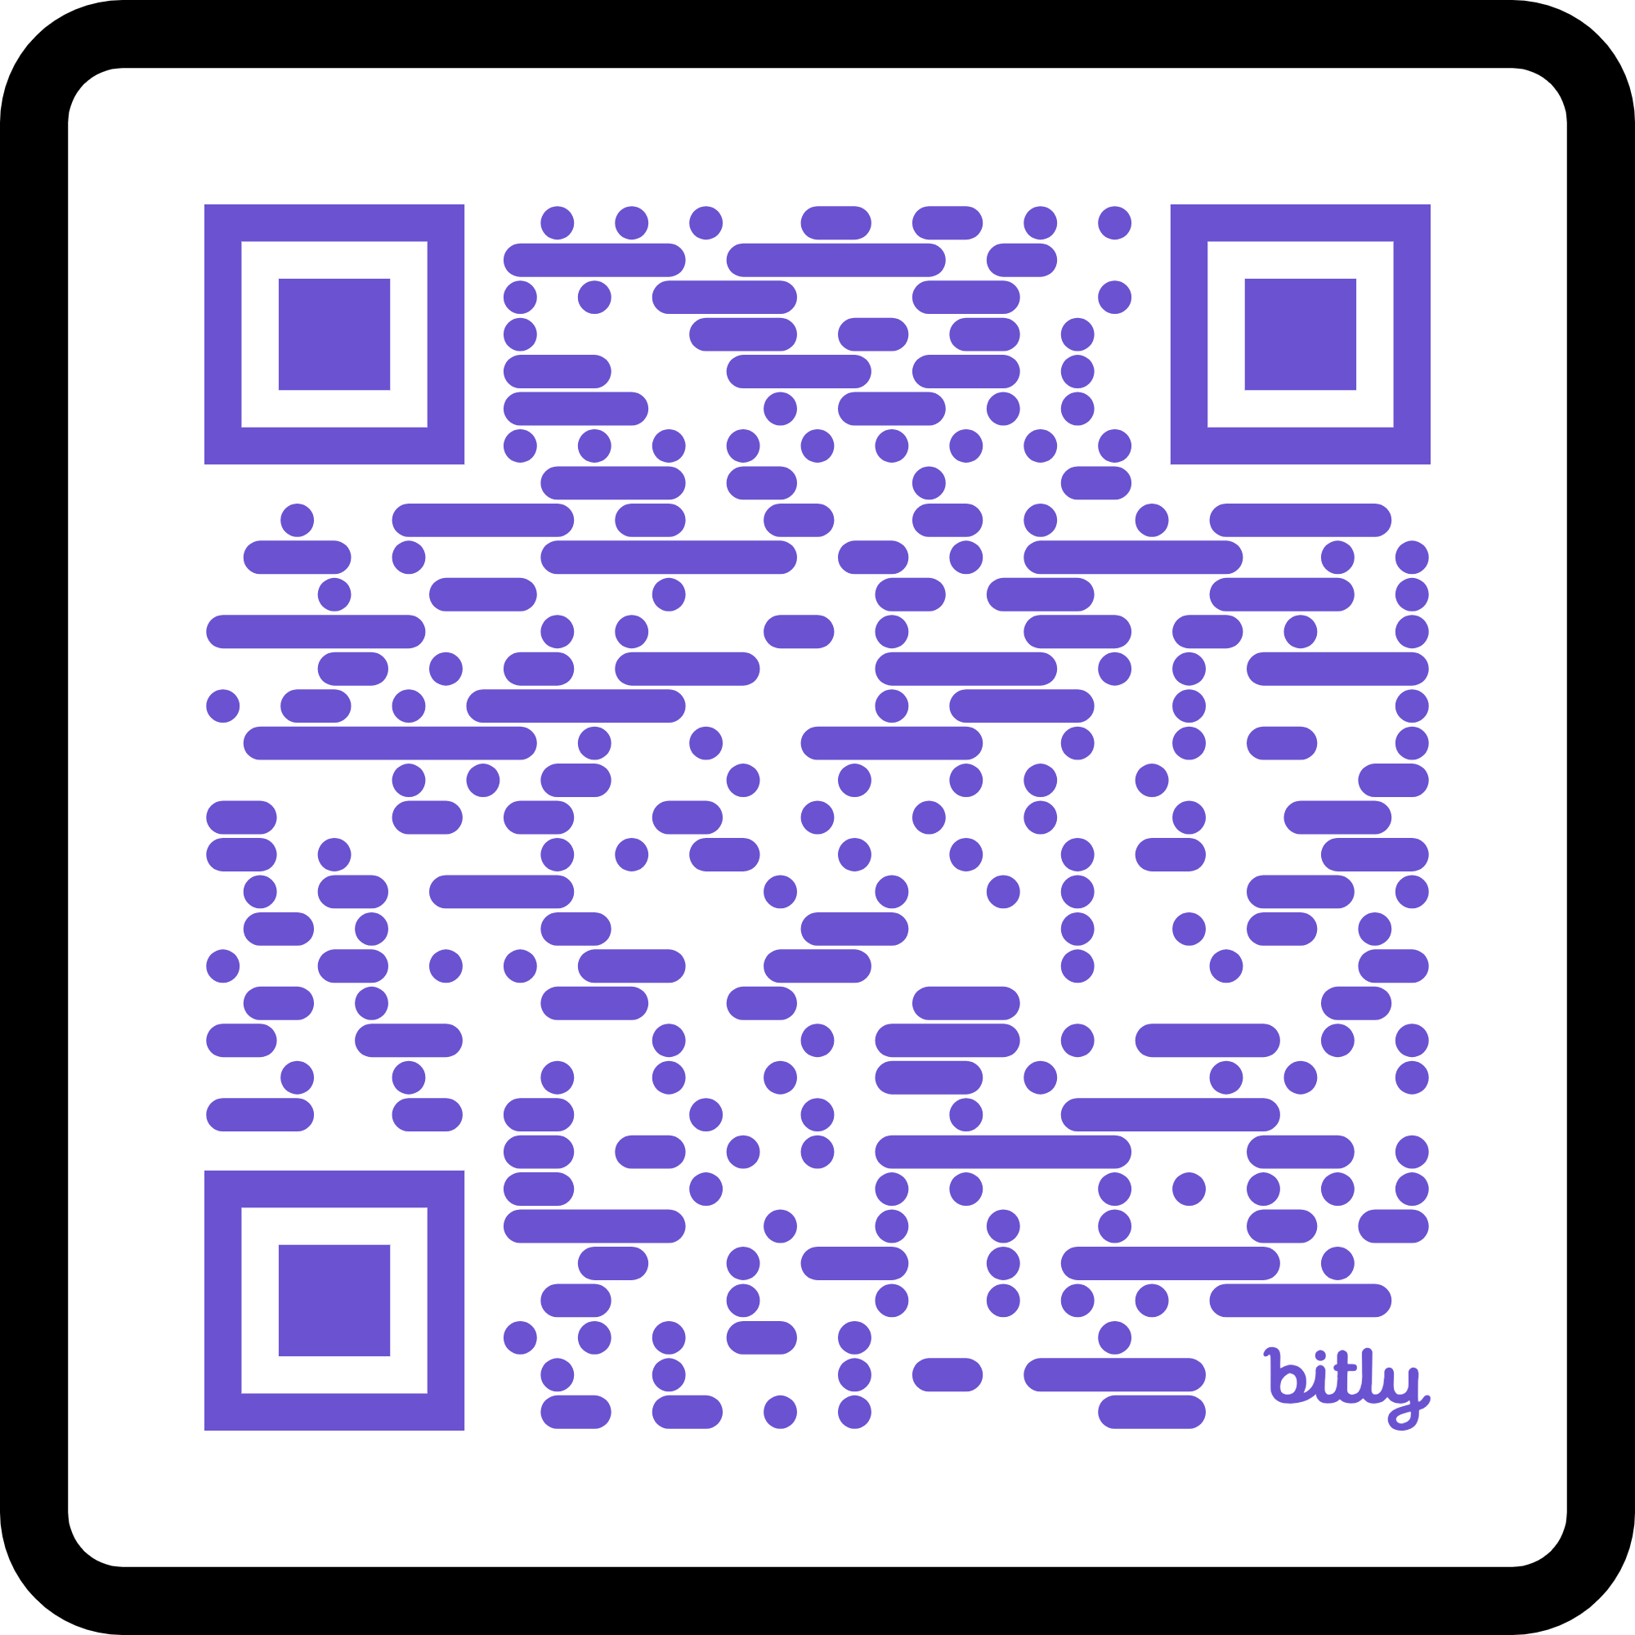
Thank You!
Slides
Scripts
Demos!
Extra resources
Contact info

